Slide 1
The Ophiocordyceps fungus

Slide 2
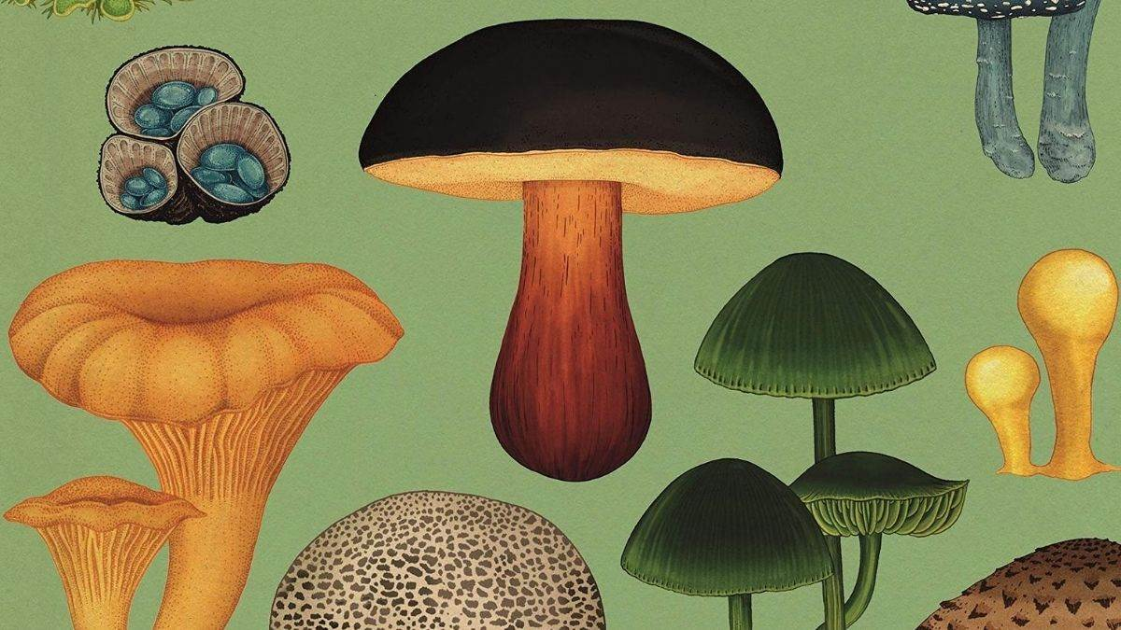
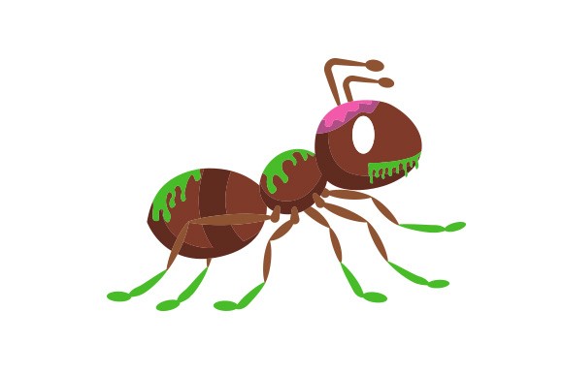
Introduction

Slide 3
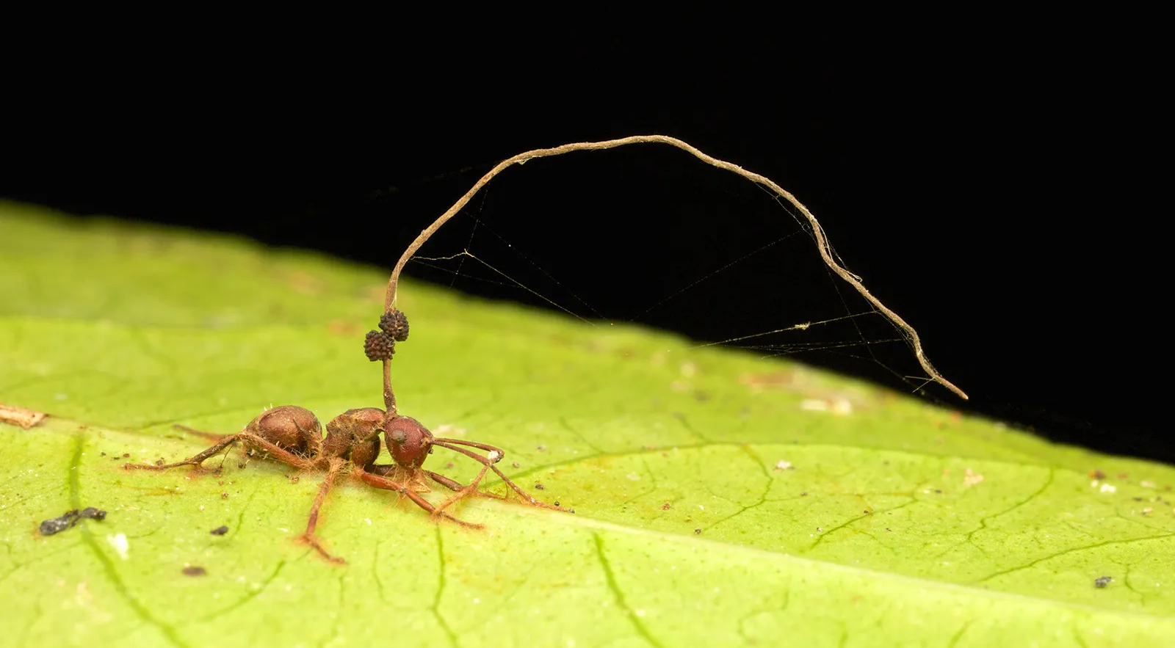
Morphology of the Fungus
Perithecium
Stroma
Dorsal protonum region

Slide 4
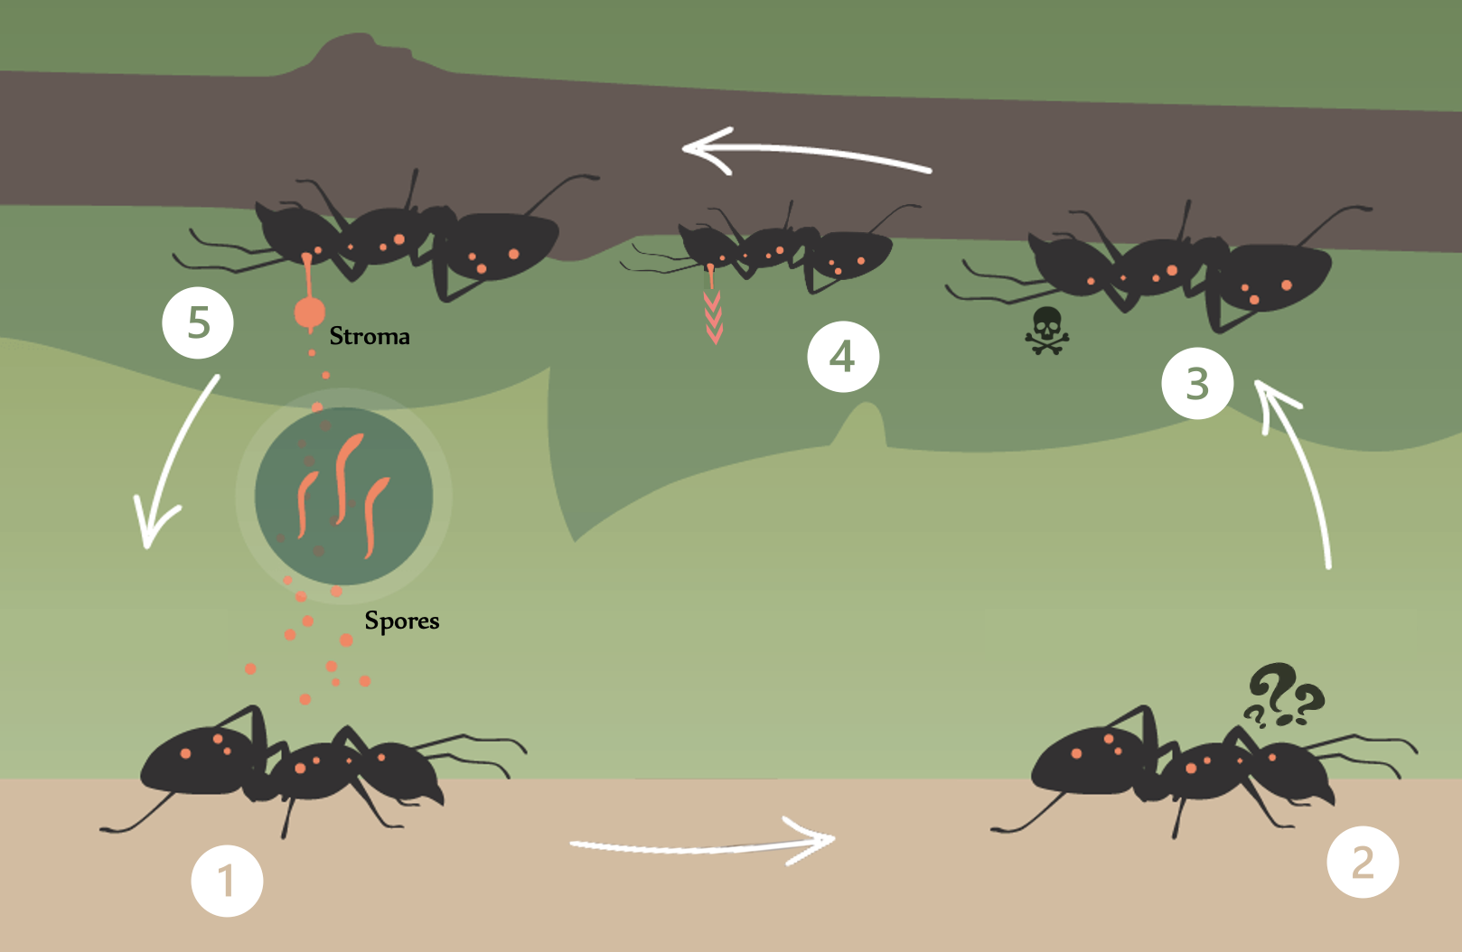
Life Cycle of the Fungus
5 Important steps
﻿﻿﻿﻿Infection
﻿﻿﻿﻿Behavioural Changes
﻿﻿﻿﻿Death
﻿﻿﻿﻿Fungus Growth
﻿﻿﻿﻿Spore Release
This process ensures the fungus' reproduction and emphasizes the remarkable ability of parasites to alter their hosts' behaviour for their own reproductive success.

Slide 5
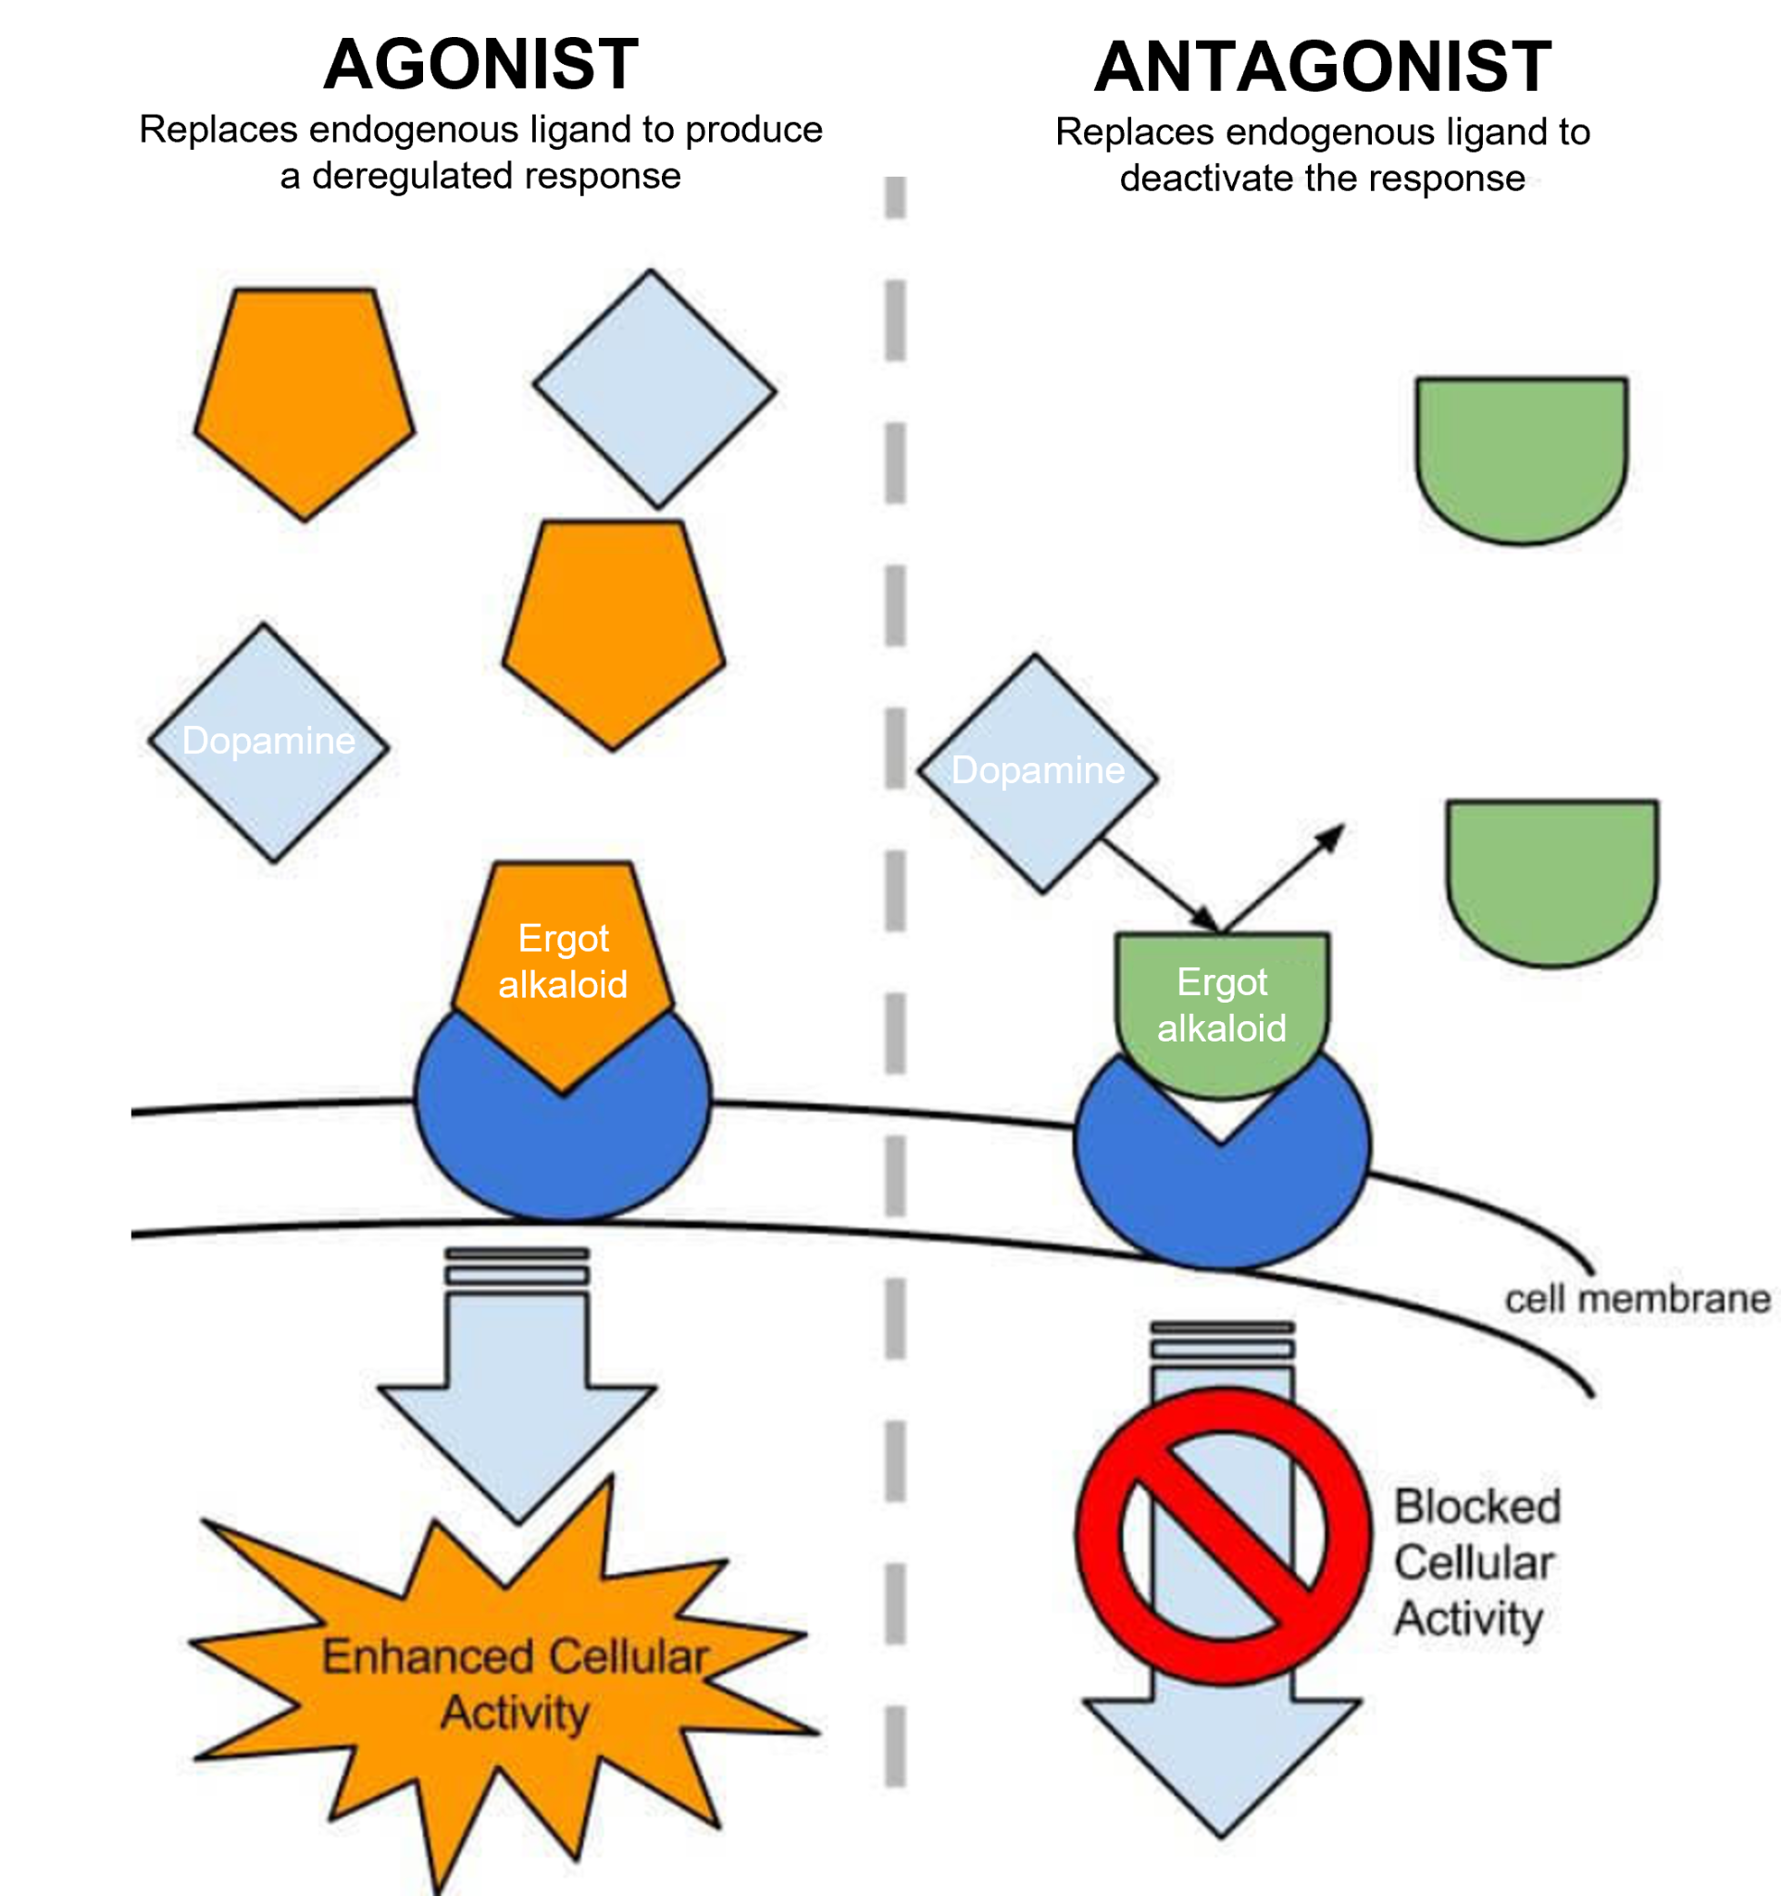
The effect of ergot alkaloids on the ant’s metabolism
1. Neurotransmitter antagonist
Ergot alkaloids interact with neurotransmitters
Serotonin, adrenaline, dopamine, …
Act on stress responses, appetite, movement, …
Two modes of action:
  Agonist
  Antagonist

Slide 6
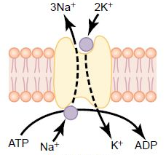
The effect of ergot alkaloids on the ant’s metabolism
2. Na⁺/K⁺ ATPase pump inhibition
Source: Guyton & Hall, Textbook of Medical Physiology
Serotonin triggers second messengers to control the behaviour of this antiporter
The pump is responsible for the regulation of electrochemical potential between both sides of the membrane
WHEN ERGOT ALKALOIDS INTERVENE:
The serotonin signalling is disrupted and the ATPase stops working properly
Bad news for neurons, as their ability to transfer action potentials depends on their membrane potentials
Disrupted nervous system!
Outside
Inside

Slide 7
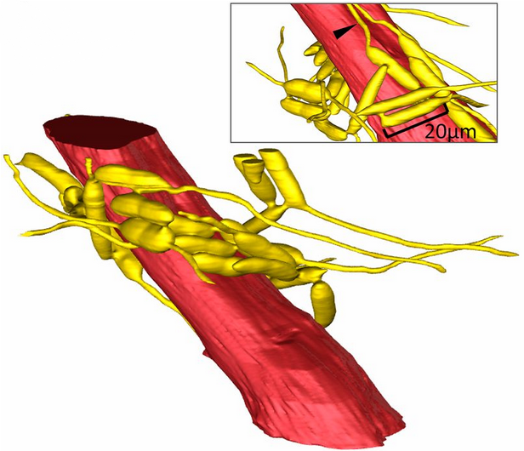
Can this fungus “zombify” humans?
1. Mode of action
→ Fungus cell network around muscle fibres and brain
→ Spread metabolites (i.e. ergot alkaloids) via this network
2. Consequences
→ Increased blood pressure
→ Cardiovascular, respiratory and gastrointestinal problems
→ Cerebral vessel dilatation and behavioural effects
3. Important factors
→ Human body’s temperature is too hot for this fungus to infect us
→ Impact of climate change
→ Human medicines
Fungus cell network around muscle fibre – Fredericksen, Maridel A., et al., Three-dimensional visualization and a deep-learning model reveal complex fungal parasite networks in behaviorally manipulated ants.

Slide 8
Thank you for your attention!

